Slide 1

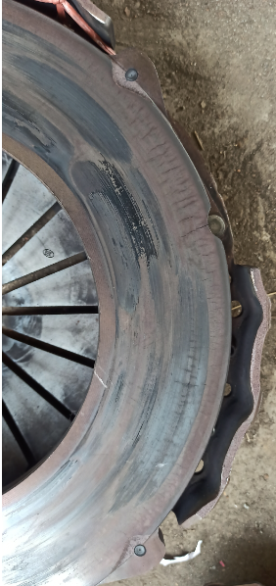
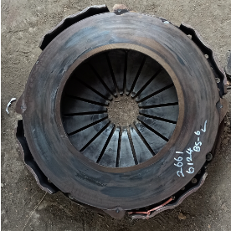
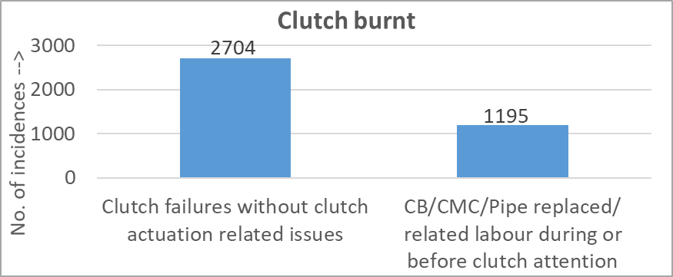
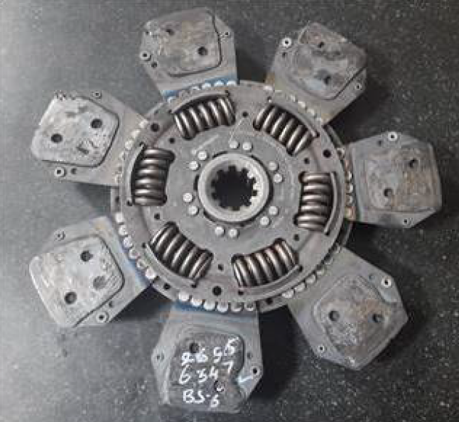
395 dia Clutch burnt - Luk
Complaint / Problem details |  | 395 Luk clutch burnt |  |  |  | Issue status | RL3
 |  |  |  |  |  | Issue grade | V1
Model |  | 3525/2825/4825 T, 5525/5425/5225 TT, 4825 H, 2825 6X4 H | Failure Hrs | Avg 1400 hours/ 63K km |  | DOF | Till Sep’22
Mfg plant |  | H2 & PNR | No of cases | 3899 |  | Resp | Application/ PD
Observation/ Root cause | Observation: Burnt marks found in pressure plate/ disc. Thermal cracks found in pressure plate No manufacturing issues observed & Clamp load in failed cover assy conforms to spec No clutch actuation related issues observed in 69% of clutch burnt failures Failure not specific to any km/ hour range Root cause: Application related issue: Overload/ Clutch drop while wheel slip/ Clutch riding |  | Photos / Illustration |  | Illustration
 |  |  |  |  | v
Action | Permanent actions : 395dia clutch with 8 pads & high clamp load under development. Doc release by Dec’22 430 dia clutch release planned. T: Jul’23 In parallel taken up with Service to reduce acceptance of burnt cases under warranty
Thermal cracks & burnt marks
Without actuation related issues
Burnt marks

Slide 2
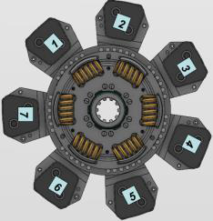
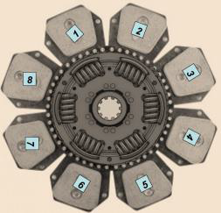
395 dia Clutch burnt - Luk
Before
After
Luk 395 dia clutch with 7 pads
Cover assy clamp load: 17300 N
Luk 395 dia clutch with 8 pads
Cover assy clamp load: 21000 N

